Slide 1
Developing Actuarial Applications Using R Shiny
PRESENTERS:
Nicholas Yeo Chee Lek
FSA
Founder and Actuary of
Nicholas Actuarial Solutions
Debbie Ooi (Min Jyeh)
Actuarial Analyst of
Nicholas Actuarial Solutions
June 2022

Slide 2
SOA Antitrust Compliance Guidelines
2

Slide 3
Presentation Disclaimer
3

Slide 4
Content
1. How R Shiny Works
2. Building R Shiny App
3. Furnishing R Shiny App
5. Gallery of R Shiny App
4. R Shiny App Performance

Slide 5
Content
1. How R Shiny Works
2. Building R Shiny App
3. Furnishing R Shiny App
5. Gallery of R Shiny App
4. R Shiny App Performance

Slide 6
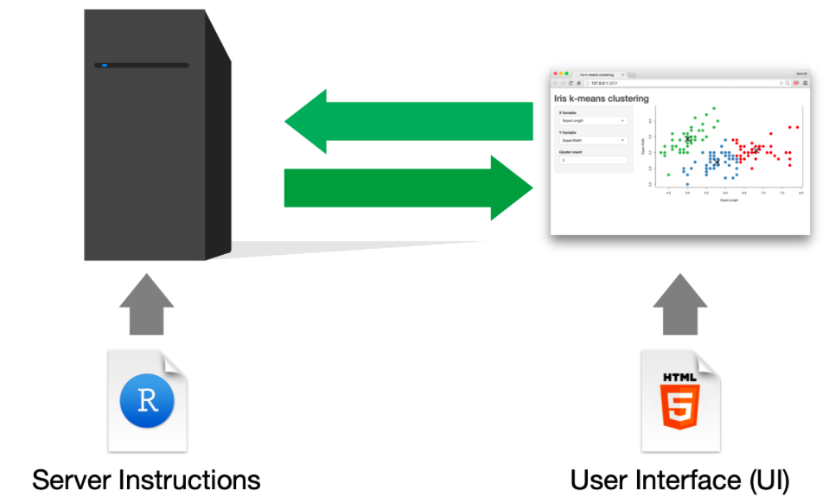

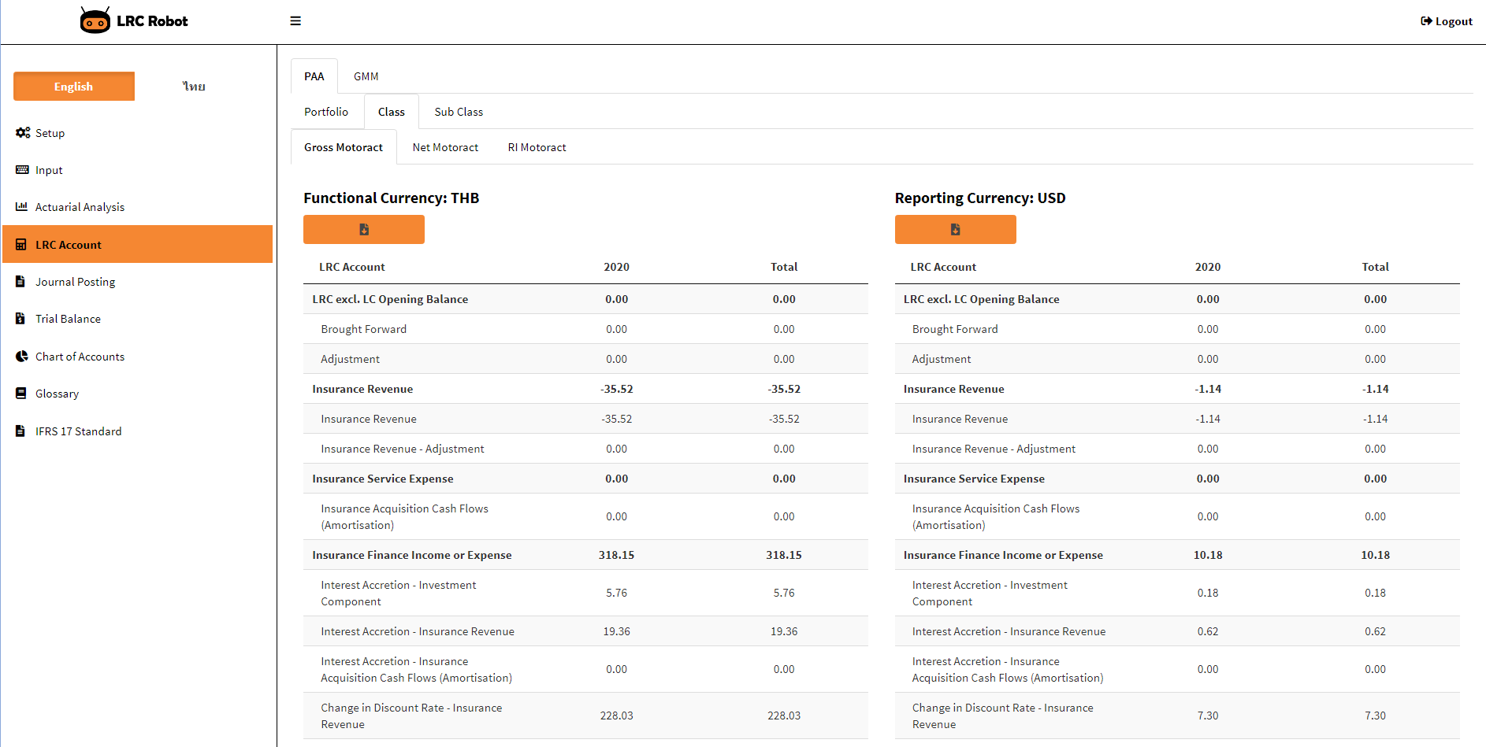
How R Shiny Works?
Server Instructions
User Interface (UI)
6

Slide 7
Content
1. How R Shiny Works
2. Building R Shiny App
3. Furnishing R Shiny App
5. Gallery of R Shiny App
4. R Shiny App Performance

Slide 8
library(shiny)
ui <- dashboardPage()
server <- function(input, output) {}
shinyApp(ui = ui, server = server)
R Shiny Package
Visual Elements
Logic Defined
Deploy App

Slide 9
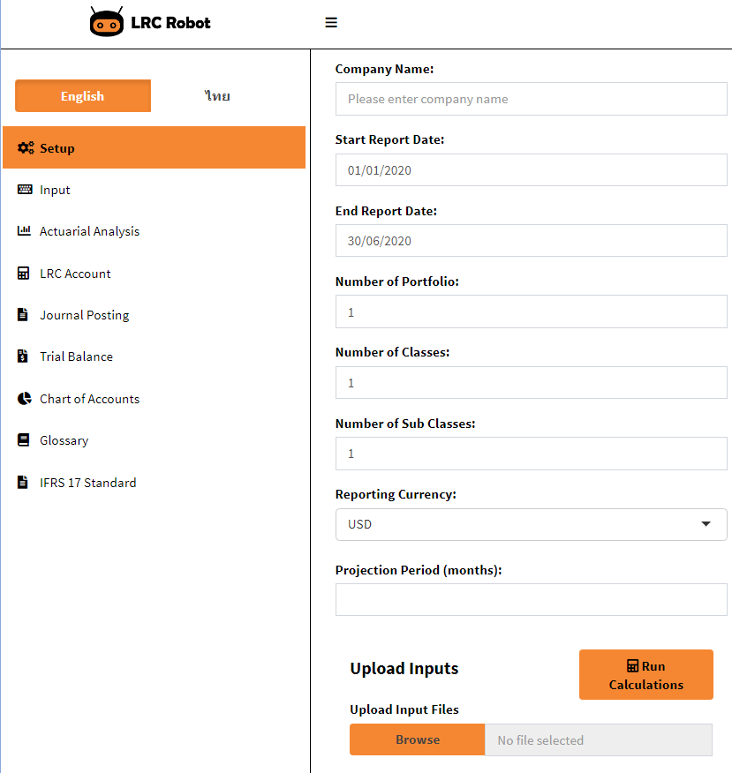
ui <-
dashboardPage(
title = “LRC Robot",
dashboardHeader(title = tags$a(
tags$img(src = "LRC.robot/LRC logo.png",
style = margin: auto;")),
href = "https://www.n-actuarial.com/",
titleWidth = 320),
dashboardSidebar(uiOutput("languagebtn"), uiOutput("sidebar"), width = 320),
dashboardBody(
useShinyjs(),
uiOutput("body"))
)
)
Header
Sidebar
Body
Source: LRC Robot by n-actuarial

Slide 10
server <- function(input, output) {
output$body <- renderUI({
tabItems(
ui_setup("setup", "Setup"),
ui_input("input", "Input"),
.
.
.
})
ui_setup <- function(id, tabName) {
tabItem(tabName = tabName,
fluidRow(
column(4,
textInput('com_name', "Company Name: ",
placeholder = "Please enter company name"),
dateInput('start_date', "Start Report Date: ",
value = '2020/01/01’,
format = "dd/mm/yyyy"),
dateInput('end_date', "End Report Date: ",
value = '2020/06/30’,
format = "dd/mm/yyyy"),
fileInput("input_data", 'Upload Input Files’,
accept = c('text/csv’, 'text/plain','.csv’), buttonLabel = "Browse")
))
)
}
}
Text input
Date input
File input

Slide 11

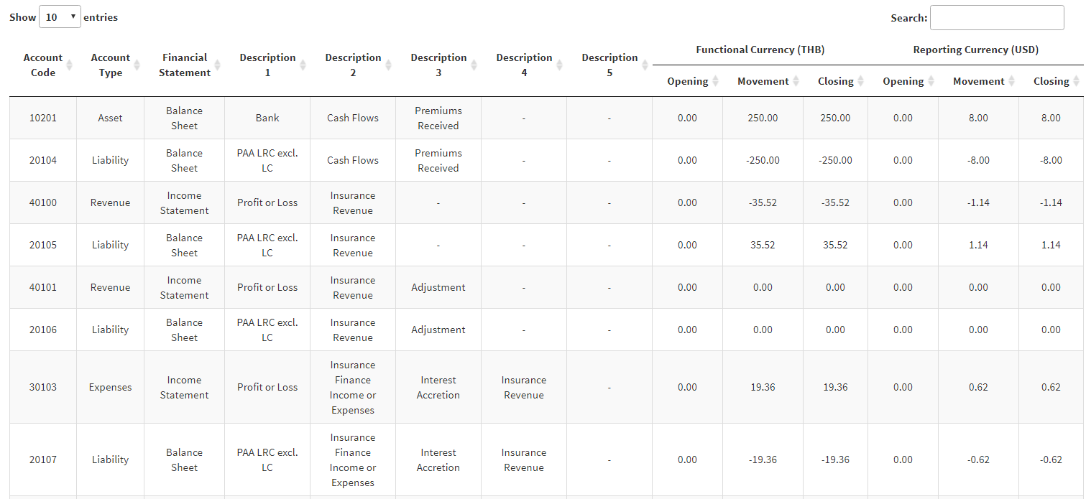
result_table <- reactive({
data = input$input_data,
coa = data.table()
coa[, “Account Code” := ...,
“Account Type” := ...,
“Financial Statement” := ...,
.
.
.
“Opening” := ...,
“Movement” := ...,
“Closing” := ...]
.
.
.
return(coa)
})
output$result_dt <-renderDataTable({
datatable(result_table())
})
output$result_download <- downloadHandler({
filename = c(‘Chart of Accounts.csv’)
content = function(file) {
write.csv(result_table(), file)}
})
output$body <- renderUI({
box(
downloadButton(“result_download”),
dataTableOutput(“result_dt”)
)
})
Output
function
Reactive function
Source: LRC Robot by n-actuarial
Render function
Download handler

Slide 12
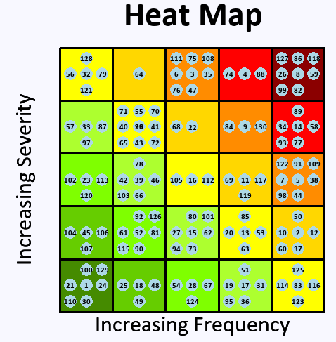
plotting = reactive({
plot(c(0, 5), c(0, 5), type = "n", asp=1, main="Heat Map", xlim=c(0,5), ylim=c(0,5), ylab="", xlab="", axes = FALSE, cex.main = 3)
mtext(text = "Increasing Severity", side = 2, line = 0, cex = 2)
mtext(text = "Increasing Frequency", side = 1, line = 0, cex = 2)
for ( i in 0:4 ) {
for ( j in 0:4 ) {
rect( 0+i, 0+j, 1+i, 1+j, border = TRUE,
col = ifelse(i+j == 0, "chartreuse4" ,
ifelse(i+j == 1, "chartreuse3",
ifelse(i+j == 2, "chartreuse",
ifelse(i+j == 3, "greenyellow" ,
ifelse(i+j == 4, "yellow",
ifelse(i+j == 5, "gold",
ifelse(i+j == 6, "darkorange",
ifelse(i+j == 7, "red", "darkred")))))))))}}
.
.
.
})
output$myplot = renderPlot({
withProgress(message = "Generating plot ...", value = 0.1, style = "notification", {
plotting()
})}, bg = "ghostwhite", height = 500, width = 500)
Source: RiskHeat by n-actuarial
Notes:
Package used:
Shiny
Plotrix
Grid
RColorBrewer

Slide 13
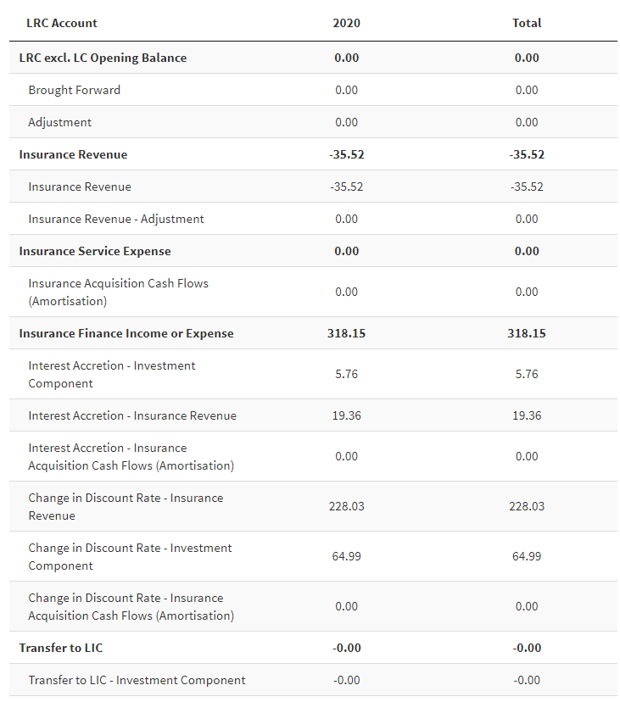
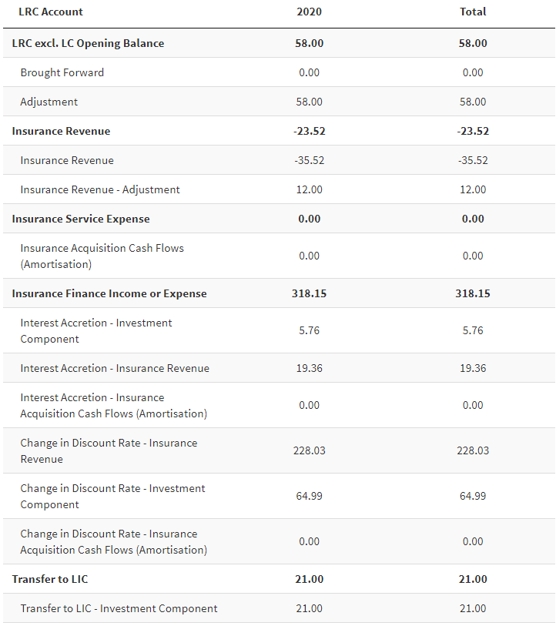
Source: LRC Robot by n-actuarial
manual_adjustment = fread(‘manual adjustment.csv’)
lrc_report = function(..., manual_adjustment){
.
.
manual_adj = manual_adjustment
.
.
set(account_lrc, i=1L, j=j,
value = results[DataType == ...] + manual_adj[DataType == ...])
.
.
.
Before manual adjustment
After manual adjustment

Slide 14
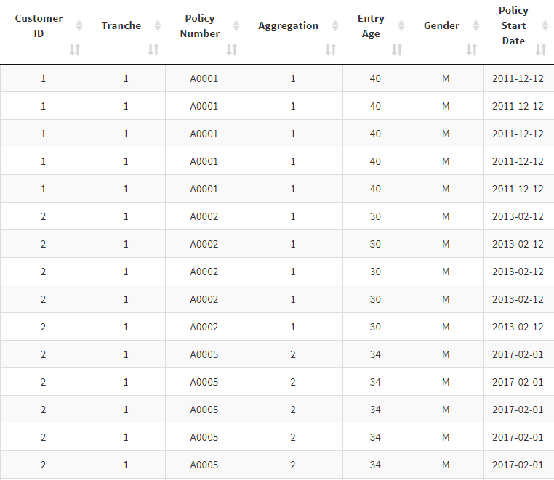
Source: ReACC by n-actuarial
cession = function(input_policy,...){
.
.
tbl = data.table(input_policy)
.
.
tbl[, ‘Aggregation’:=
cumsum(!duplicated(‘PolicyNumber`)),
by = ‘CustomerID’]
.
.
}

Slide 15
Content
1. How R Shiny Works
2. Building R Shiny App
3. Furnishing R Shiny App
5. Gallery of R Shiny App
4. R Shiny App Performance

Slide 16
Cascading Style Sheets (CSS)
Hypertext Markup Language (HTML)
JavaScript
RMarkdown
Application Programming Interface (API)
……
Notes:
Furnishing R shiny app

Slide 17
output$sidebar <- renderUI({
sidebarMenu(
menuItem("Setup", tabName = "Setup",
icon = icon("cogs")),
menuItem("Input", tabName = "Input",
icon = icon("keyboard")),
menuItem("ActuarialAnalysis",
tabName = "ActuarialAnalysis",
icon = icon("chart-bar")),
menuItem("Accounting", tabName = "Accounting",
icon = icon("calculator")),
menuItem("Posting", tabName = "Posting",
icon = icon("file-alt")),
menuItem("TrialBalance",
tabName = "TrialBalance,
icon = icon("file-invoice-dollar")),
menuItem("ChartOfAccount",
tabName = "ChartOfAccount",
icon = icon("chart-pie")),
menuItem("Glossary", tabName = "Glossary",
icon = icon("book")),
menuItem("IFRS17Doc", tabName = "IFRS17Doc",
icon = icon("file-alt"))
)
})
Source: LRC Robot by n-actuarial
Notes:
Starting to build

Slide 18
Content
1. How R Shiny Works
2. Building R Shiny App
3. Furnishing R Shiny App
5. Gallery of R Shiny App
4. R Shiny App Performance

Slide 19
Run R Shiny app via profvis R package
Interact with R Shiny app, and then close
Load profile
Data Size (no. of rows) | No. of CPU | Time (sec) | Memory (MB) | Relative (time)
10,000 | 4 | 10.74 | 2,104.0 | -
 | 8 | 9.36 | 2,239.2 | 1.15x
 | 12 | 8.99 | 2,123.9 | 1.19x
50,000 | 4 | 14.11 | 8,205.3 | -
 | 8 | 13.13 | 8,479.6 | 1.07x
 | 12 | 13.10 | 8,559.6 | 1.08x
100,000 | 4 | 21.59 | 16,547.5 | -
 | 8 | 20.05 | 16,125.1 | 1.08x
 | 12 | 19.89 | 15,849.7 | 1.09x
300,000 | 4 | 44.86 | 47,662.3 | -
 | 8 | 44.86 | 48,182.6 | 1.00x
 | 12 | 44.67 | 48,421.6 | 1.00x
500,000 | 4 | 77.27 | 57,552.0 | -
 | 8 | 78.76 | 57,366.9 | 0.98x
 | 12 | 77.33 | 59,538.8 | 1.00x
library(profvis)
profvis({ runApp(‘R_shiny_app_dir’) },
prof_output=‘/profile_dir’)
profvis(prof_input = ‘/output_dir/profile.Rprof’)
Table: Sample of R Shiny App performance test
Notes:
The Profvis package is a tool for helping you to understand how R spends its time. It provides an interactive graphical interface for visualizing data from Rprof (R’s built-in tool for collecting profiling data).

Slide 20
Content
1. How R Shiny Works
2. Building R Shiny App
3. Furnishing R Shiny App
5. Gallery of R Shiny App
4. R Shiny App Performance

Slide 21
Source: LRC Robot by n-actuarial

Slide 22
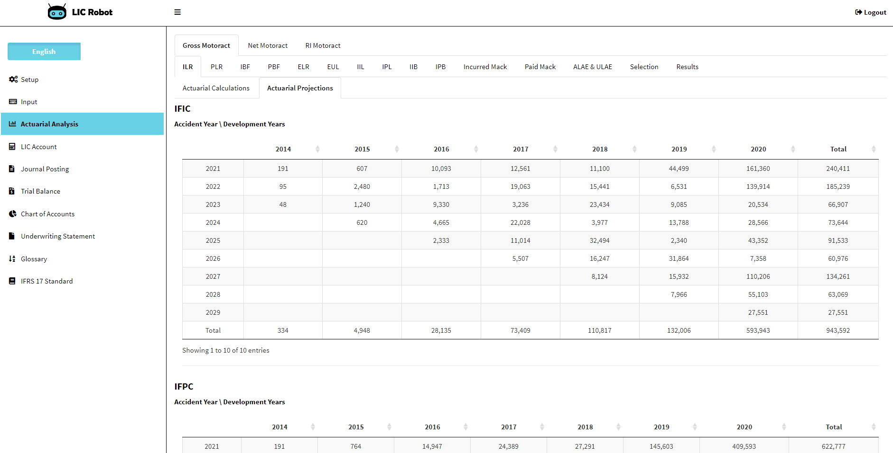
Source: LIC Robot by n-actuarial

Slide 23
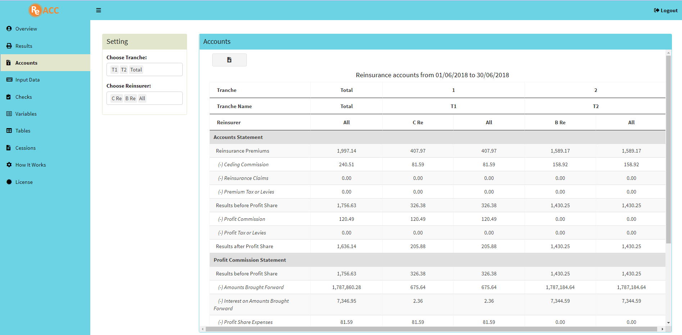
Source: ReACC by n-actuarial

Slide 24
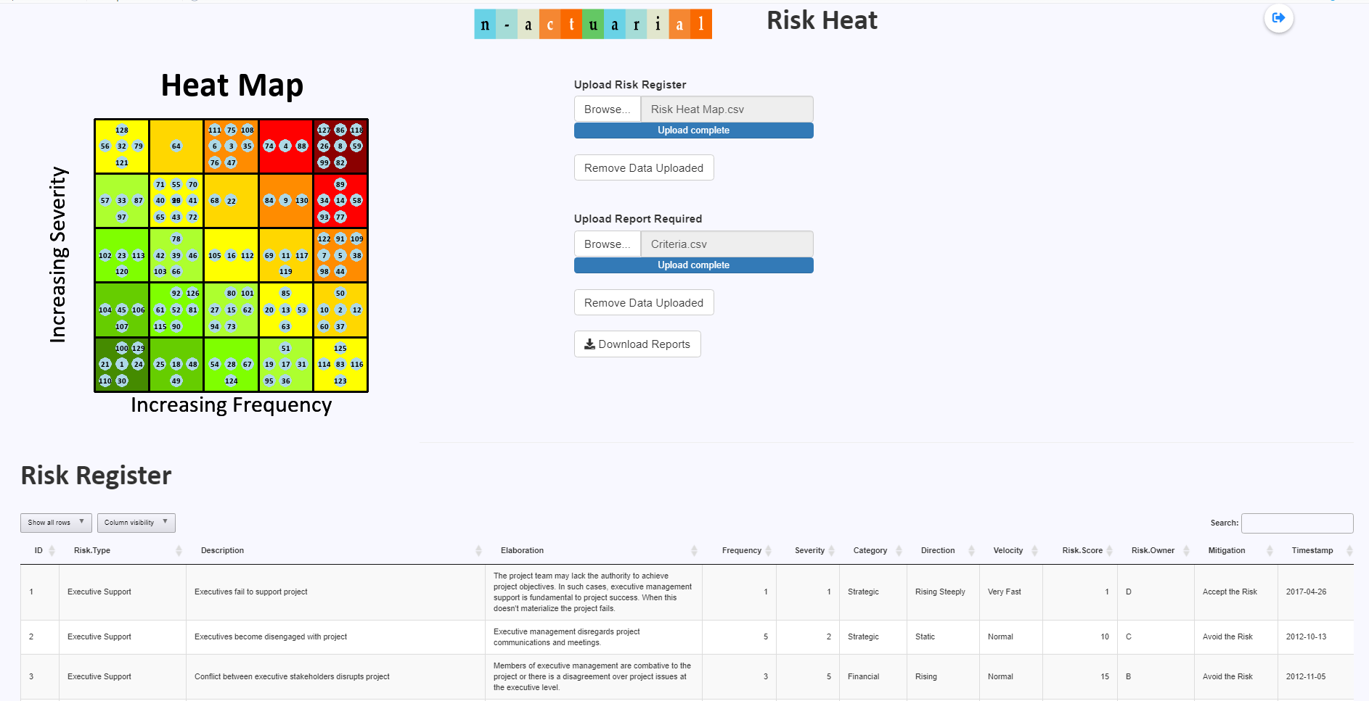
Source: RiskHeat by n-actuarial

Slide 25
Thank You
PRESENTERS:
Nicholas Yeo Chee Lek
FIA FASM FSA FSAS FSAT
Founder and Actuary of
Nicholas Actuarial Solutions
Debbie Ooi (Min Jyeh)
Actuarial Analyst of
Nicholas Actuarial Solutions
June 2022

